Slide 1

E-Scrap Management System
developed at
TOPS Technologies Pvt Ltd.- Vadodara
Under The Guidance Of
Internal Guide
Prof. Hardik Parmar.
External Guide
Ms. Ekta Kathad.
Developed By
Shivkumar Patil(2205112070020)
Submitted To:
Department of MCA
Faculty of IT & Computer Science,
PARUL University
E-SCRAP MANAGEMENT
1

Slide 2
Index:
Project Profile.
Requirement analysis.
Design.
Implementation.
Testing.
Future enhancement.
Bibliography.

Slide 3
1. Project Profile:
E-Scrap Management [Electronic Scrap]: Design an online E-scrap management portal.. The portal aims to provide users with a seamless and enjoyable journey from product discovery to purchase.
E-Scrap world where we provide you the whole management of your scrap through our web applications.
As Scrap of one company could be used as a raw material for other industry.

Slide 4
In this new digitalized world we provide you the platform for company where company can upload there scrap on our website and get the good price for their scrap from the scrap dealer.
We also provide one time bidding system for each scrap dealer on scrap and company can flexible to select any scrap dealer as a winner for their scrap.
Scrap Dealer can view the scrap and bid on the scrap before the time limit is over and time limit is 10 days for bidding process.
The main task of this project is how we can sell the any type of scrap online.

Slide 5
2. Requirement Analysis:
Feasibility Study:- A feasibility study is crucial to assess the viability and practicality of implementing a PHP & Mysql project for an online Scrap portal. It involves evaluating various aspects such as technical, operational, economic, legal, and scheduling factors.
Users of the System:-In the context of a PHP & Mysql project for an online Bidding portal, the users of the system can be categorized into different roles, each having distinct needs and expectations. Understanding these user roles is essential for designing a user interface and experience that caters to diverse user requirements.

Slide 6
Modules: The modules for a PHP project in an online Scrap portal are designed to cater to specific functionalities and aspects of the user experience.
There are three types of Modules.
1] ADMIN
2] COMPANY
3] SCRAP BUYER

Slide 7
[1] Admin
Login: -Admin can login using email id and password.
Manage Category: -Admin can insert, update and delete the category.( i.e paper, chemical, electronic.)
Manage company - Admin can insert, update and delete the
company.
Manage Scrap Buyer –Admin can insert, update Buyer and delete the scrap
Verify scrap:- Admin can verify scrap.
View complain:-Admin can view complain.
Update complain status: -Admin can update status of complain.
Reports: -Admin can view all the reports.

Slide 8
[2] Company
Registration: -Company can register by filling registration form.
Login: - Company can login after 24 hours after registration for first time
After that he/she can login anytime by registered email id & Password
Upload: -Company has to upload scrap.
Scrap Wise Bidding: -Company can view bidding on their scrap
Select Winner: -Company has to select winner.
Complain: - Company can complain against scrap buyer.
View Complain status: -Company can view their complain status.
Logout: -Company can logout.

Slide 9
[3] Scrap Buyer
Registration: -Scrap Buyer can register by filling registration form.
Login: - Scarp Buyer can login after 24 hours after registration for first time
After that he/she can login anytime by registered email id & Password.
View Scrap: -Scrap Buyer can view scrap
One Time Bid: -Scrap Buyer can bid on scrap one time on each scrap only.
View Bidding: -Scrap Buyer can view bidding of scrap which he/she has done bidding.
View Winner/Lose: -Scrap Buyer can view wheter he/she has won the bid or lose. Scrap Buyer can see result after 10 days of scrap uploaded.
Complain: - Scrap Buyer can complain against company.
View Complain status: - Scrap Buyer can view their complain status.
Logout: -Company can logout.

Slide 10
Hardware & Software Requirements:-
Hardware Requirement
Processor: Intel Core i3,i5…
Hard Disk: 1 TB
RAM: 4 GB
Software Requirement
WAMP Server: 2.4
APACHE Version: 2.4.4
MYSQL: 5.6.12

Slide 11
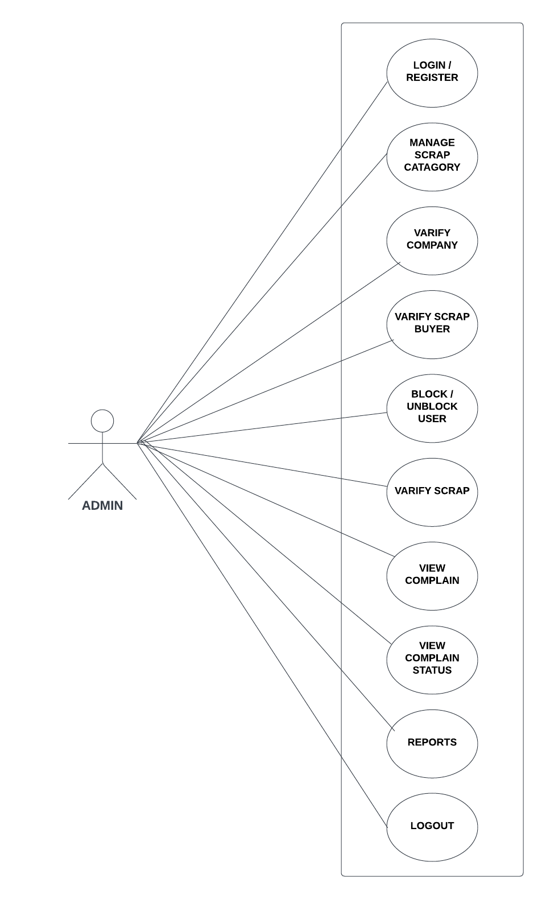

Slide 12
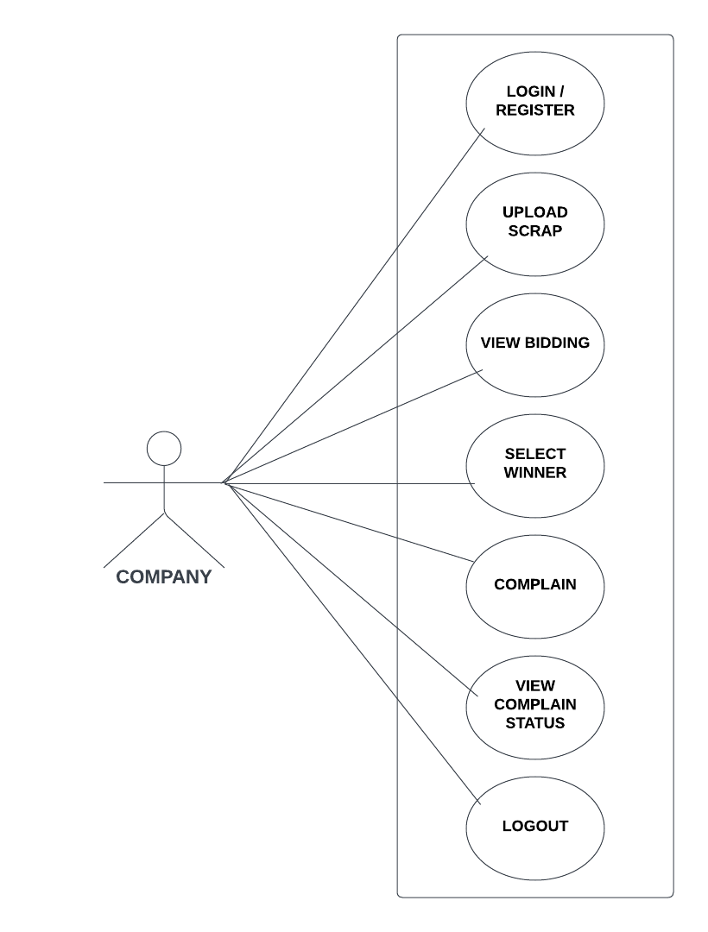

Slide 13
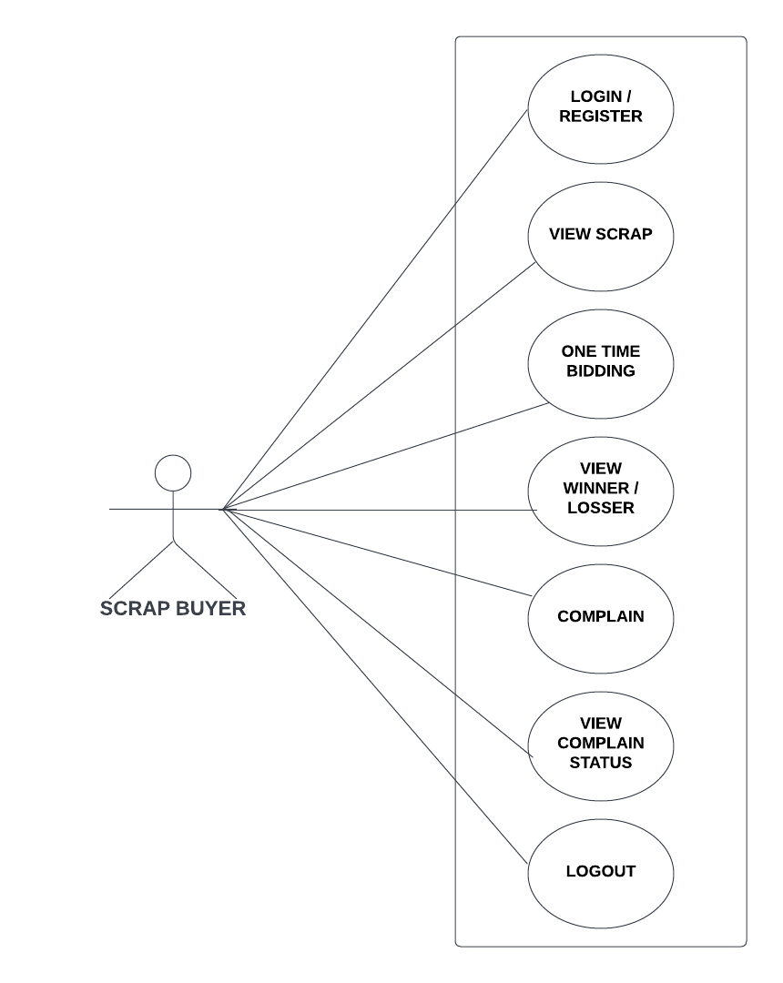

Slide 14
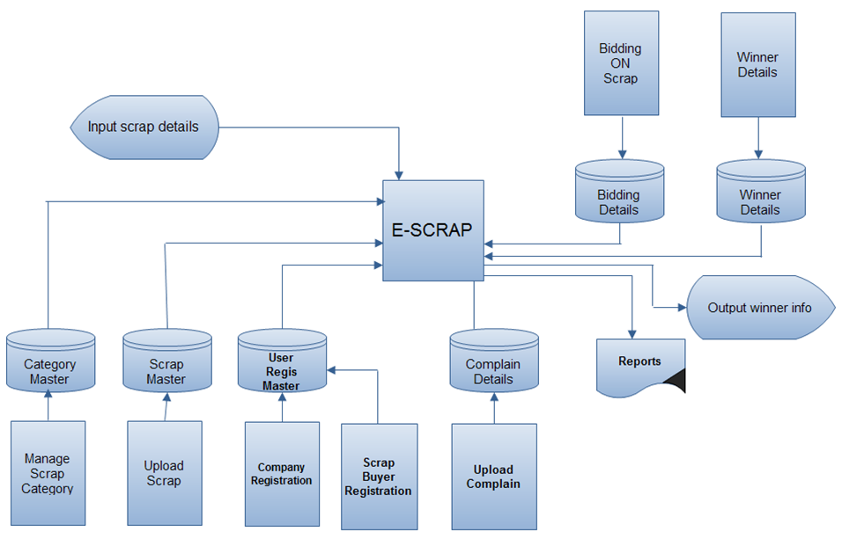
3. Design:
SYSTEM FLOW DIAGRAM

Slide 15
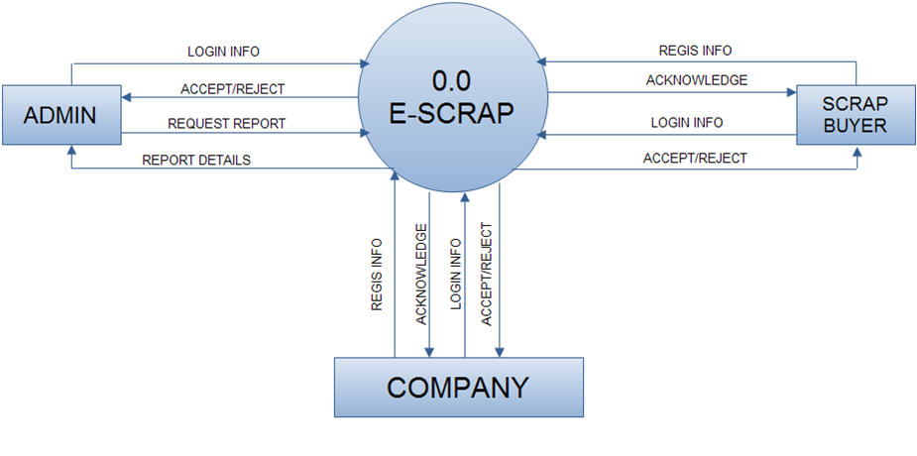
ZERO LEVEL DFD

Slide 16
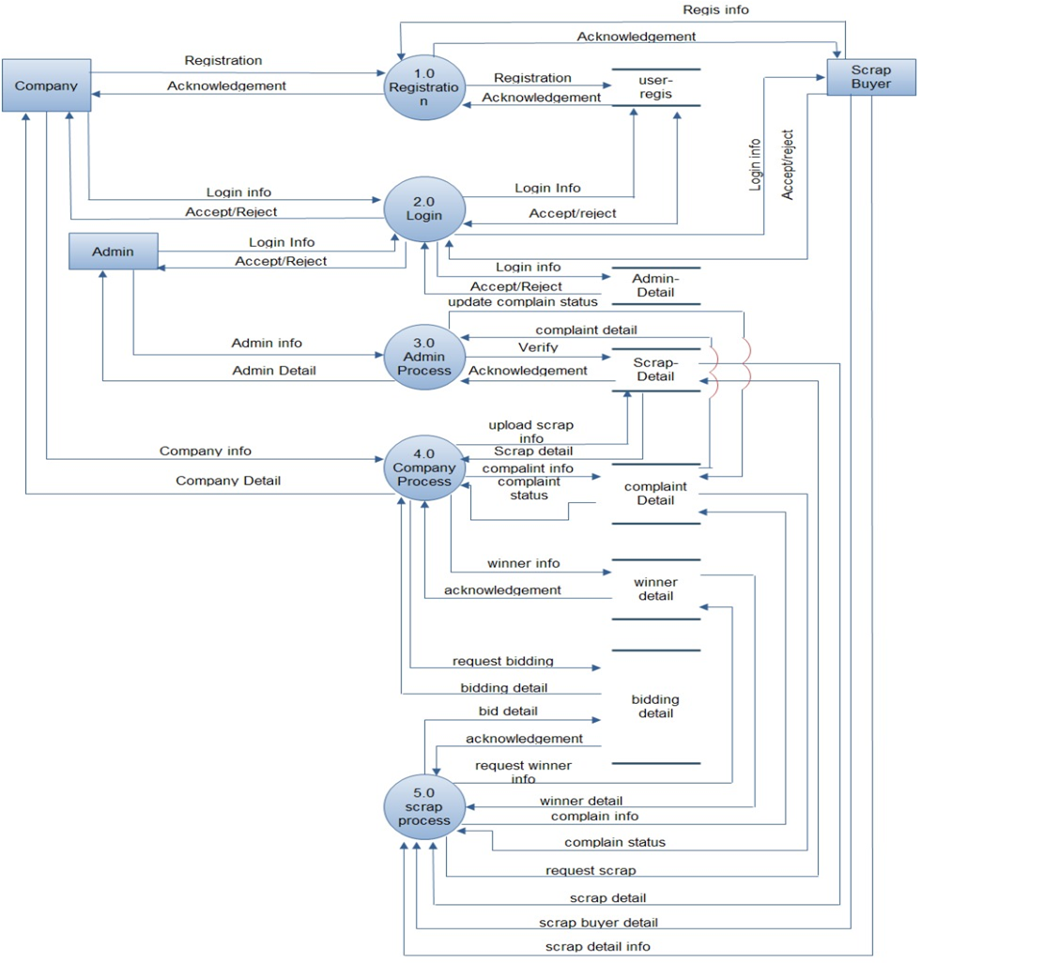
FIRST LEVEL DFD

Slide 17
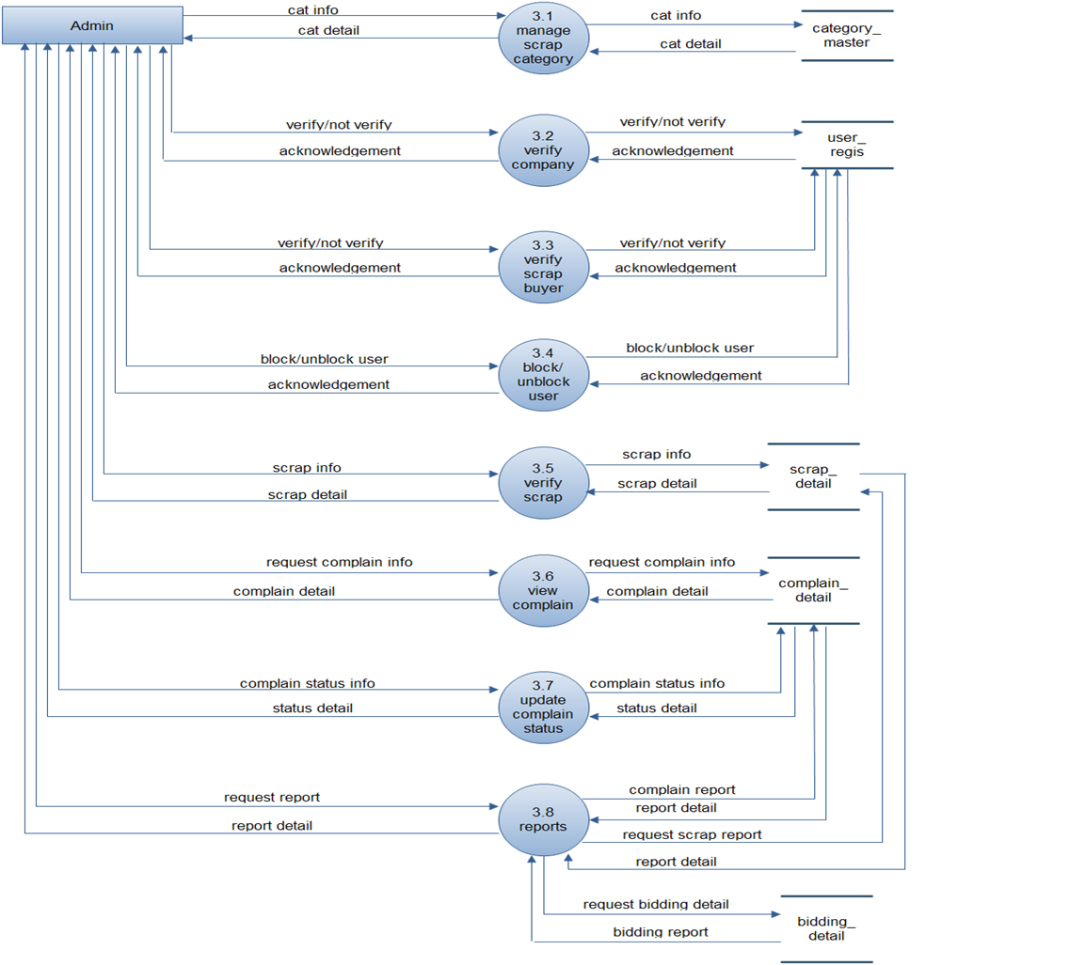
SECOND LEVEL DFD 3.0 FOR ADMIN

Slide 18
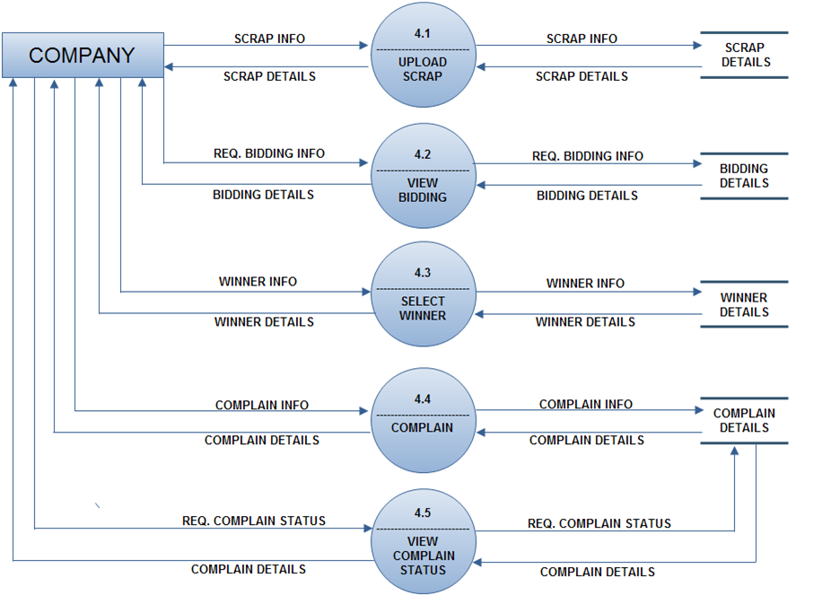
SECOND LEVEL DFD FOR COMPANY 4.0

Slide 19
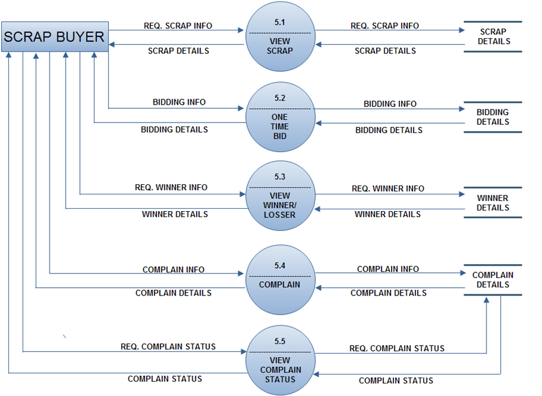
SECOND LEVEL DFD FOR 5.0

Slide 20
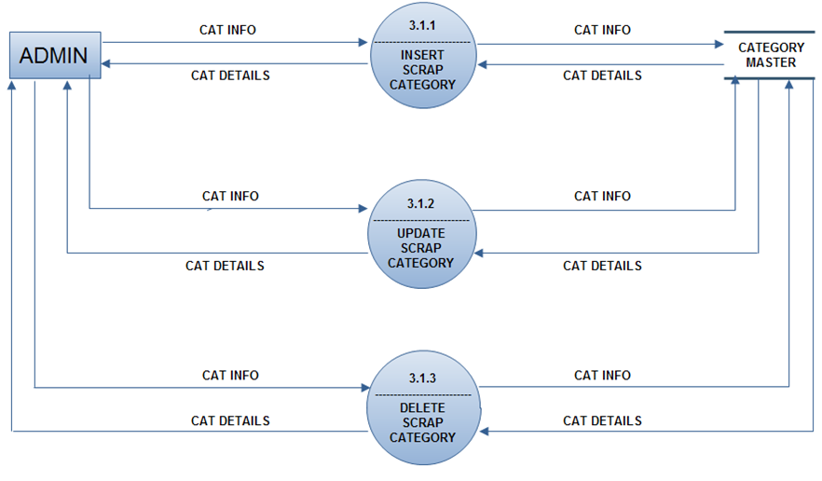
THIRD LEVEL DFD FOR SCRAP CATEGORY 3.1

Slide 21
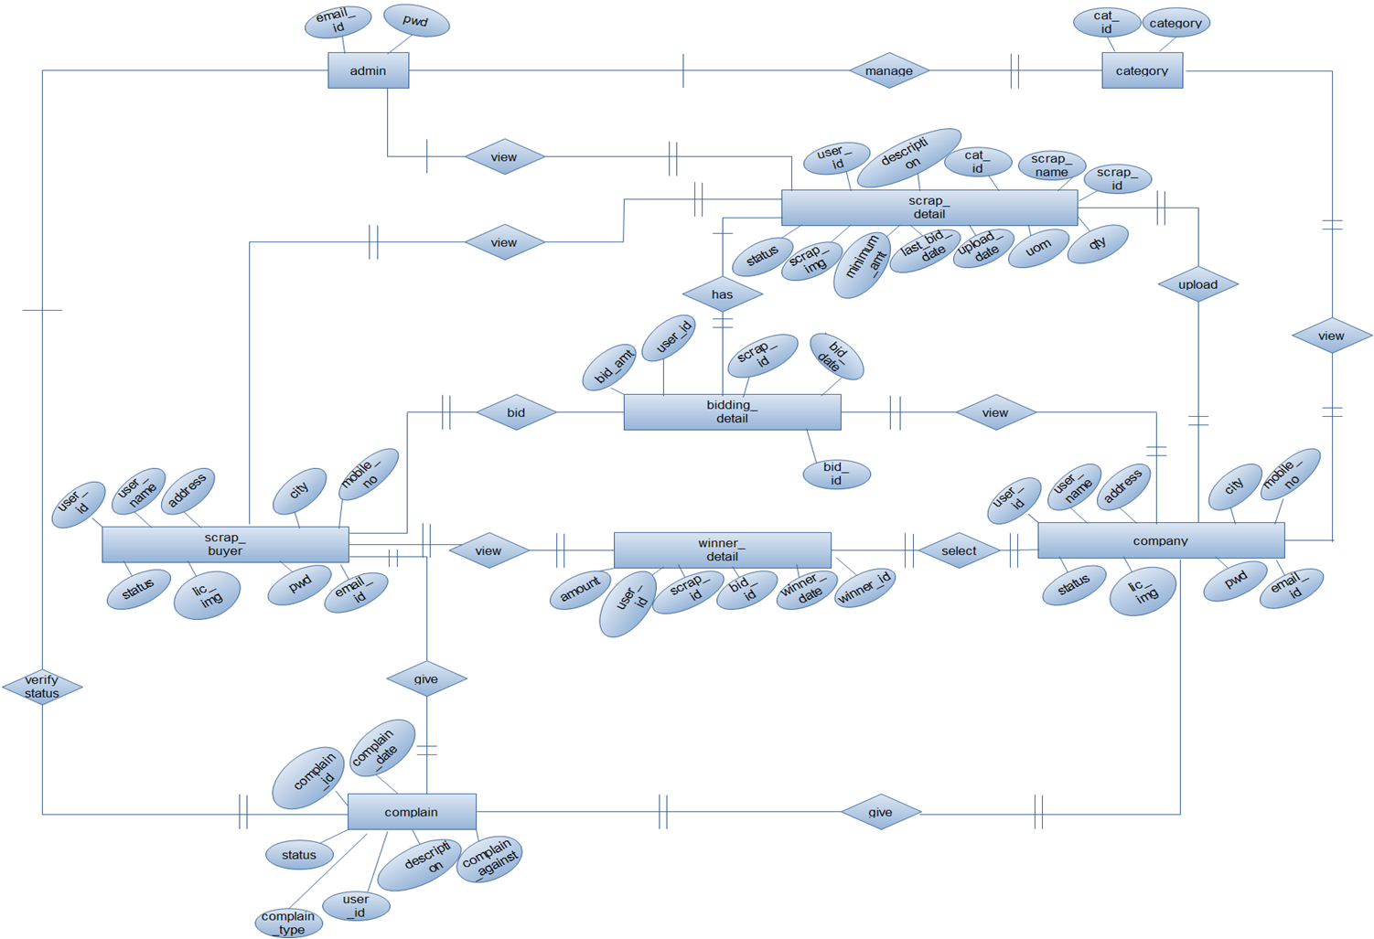
Entity Relationship Diagram

Slide 22
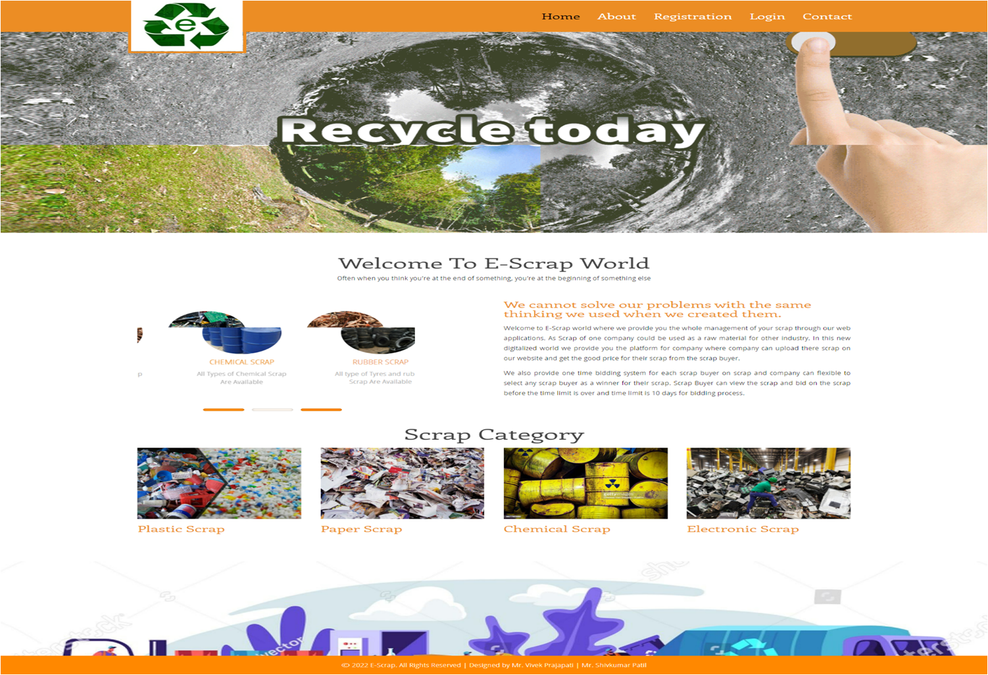
4. Implementation:
1.Home Page

Slide 23
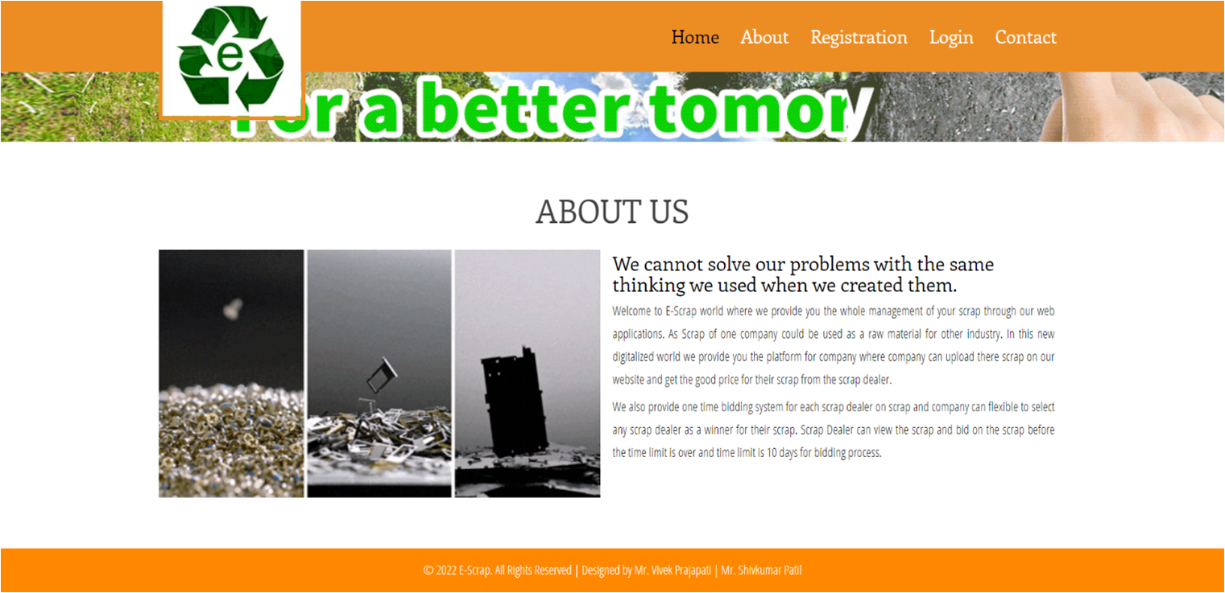
2.About us

Slide 24
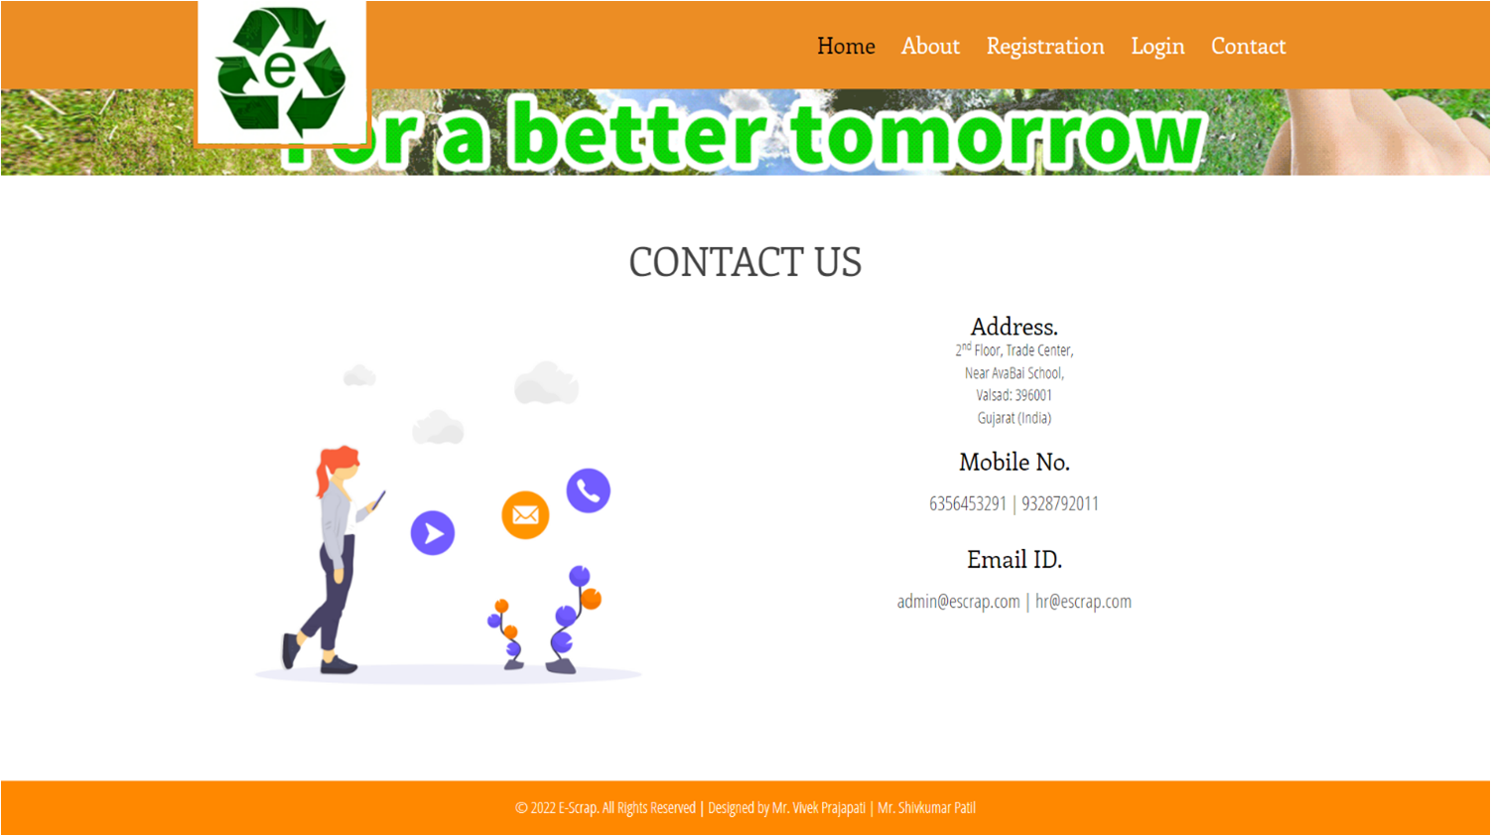
3.Contact us

Slide 25
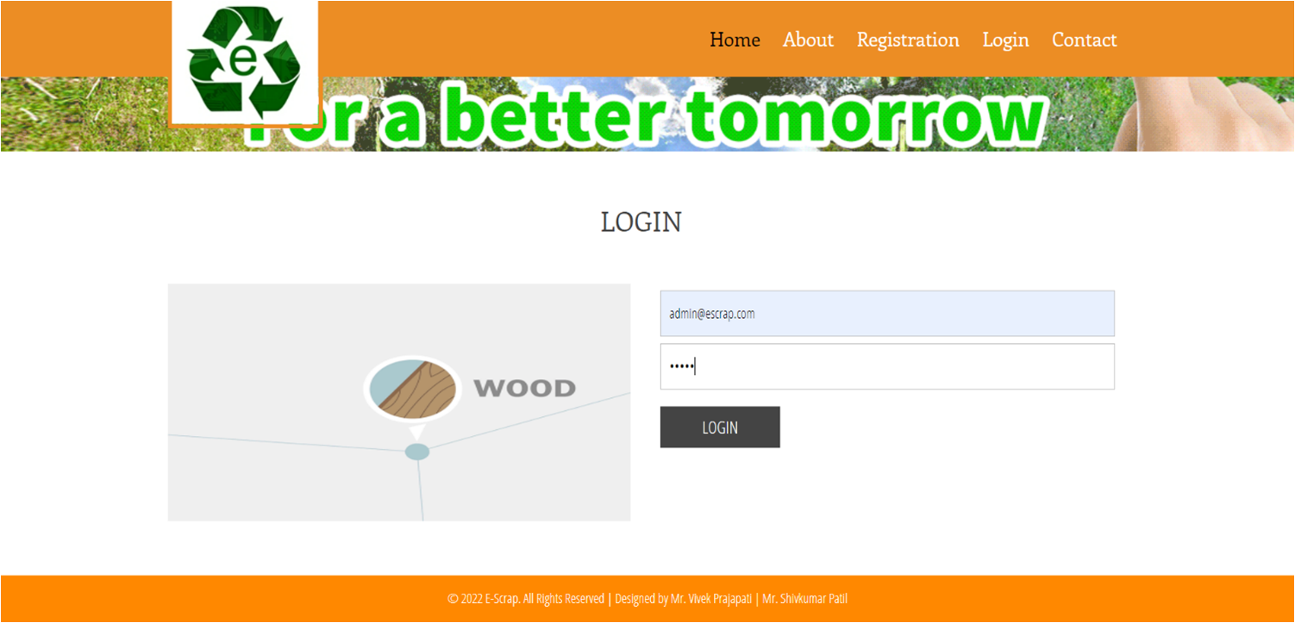
4.Admin Login

Slide 26
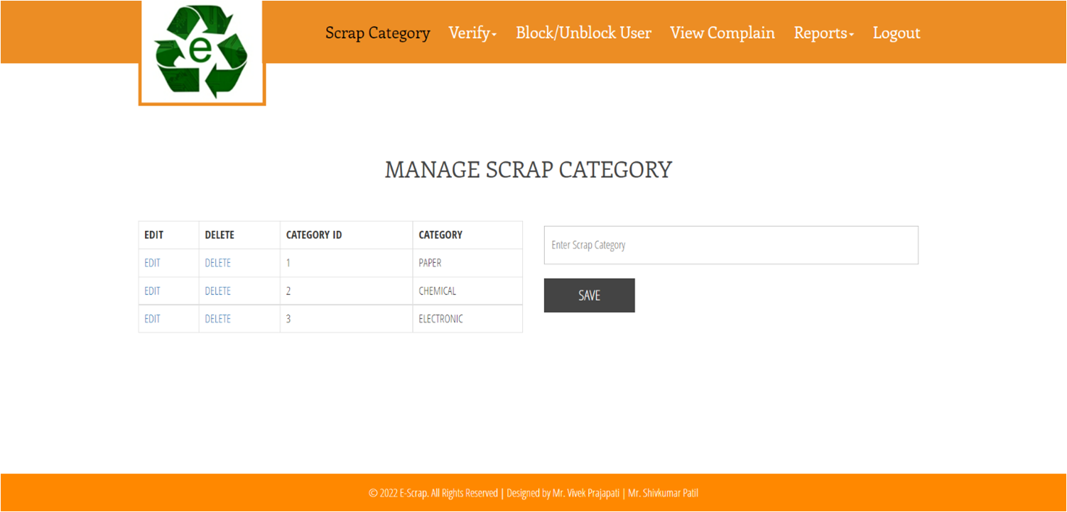
5.Manage Scrap Category

Slide 27
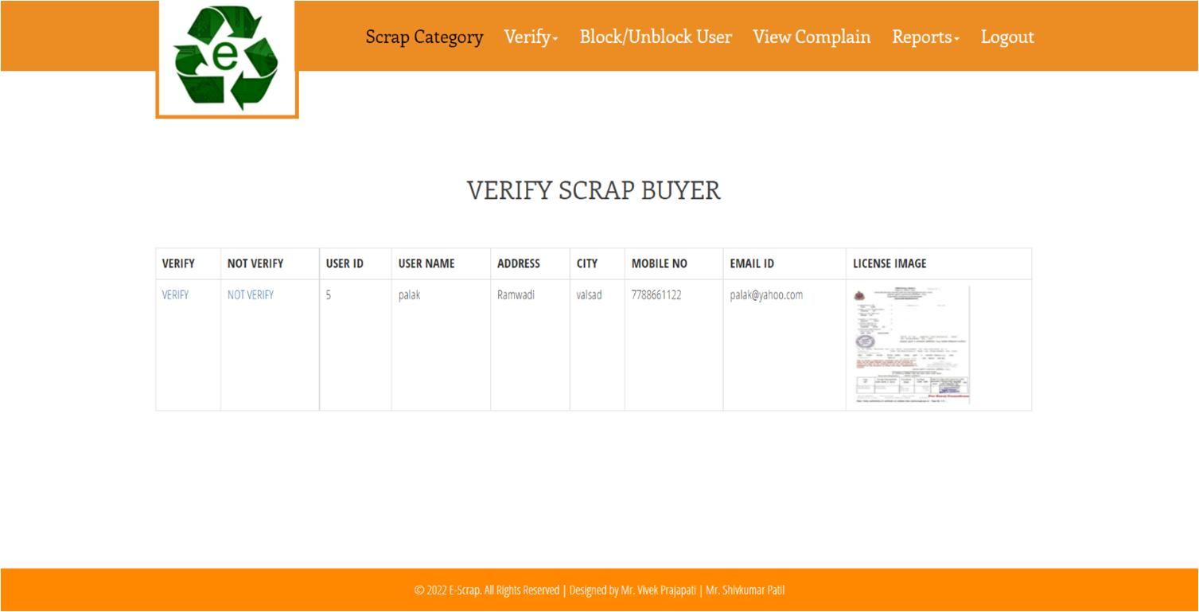
6. Admin Verify Scrap Buyer

Slide 28
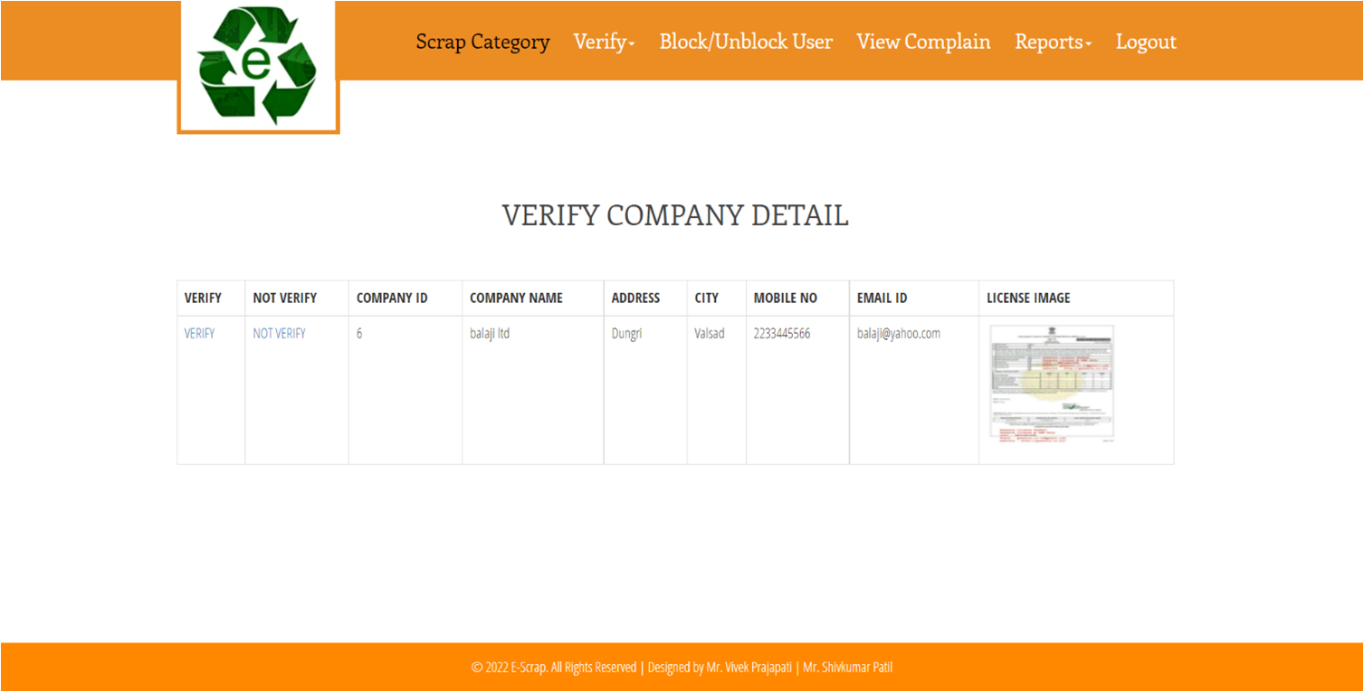
7. Admin Verify Company

Slide 29
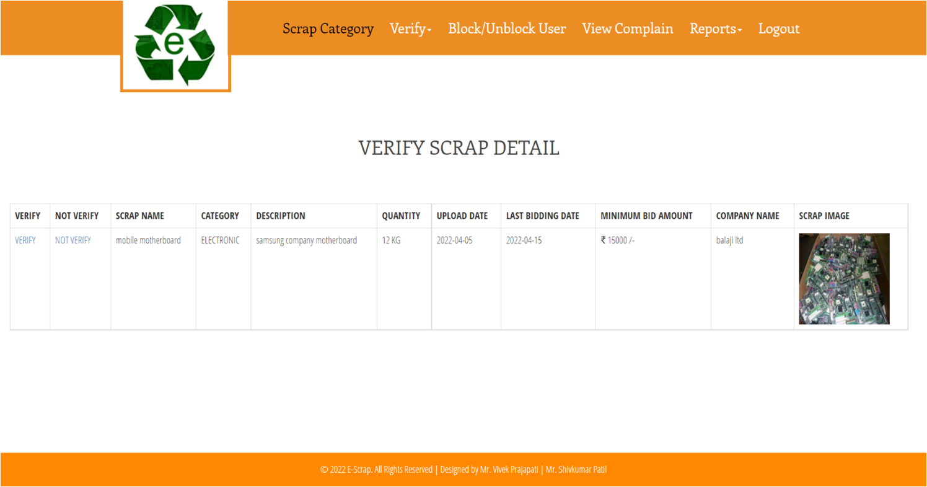
8. Admin Verify Scrap

Slide 30
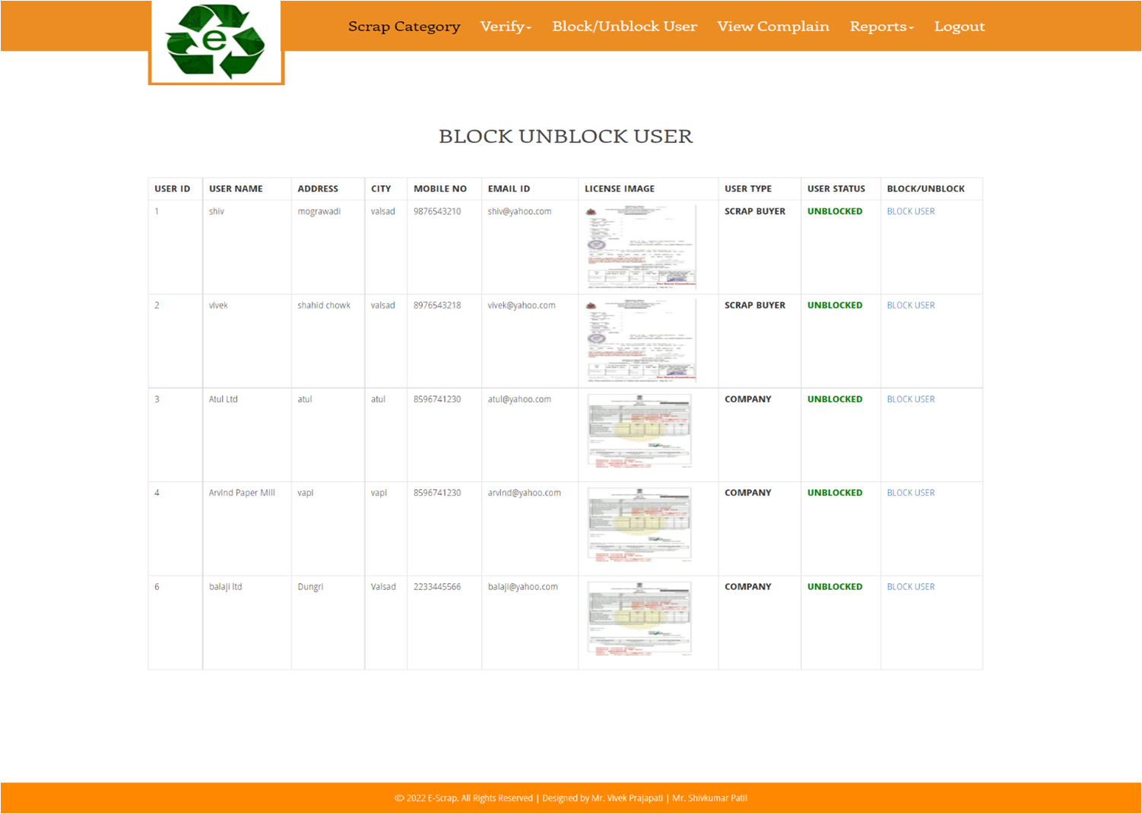
9. Admin Block/Unblock User

Slide 31
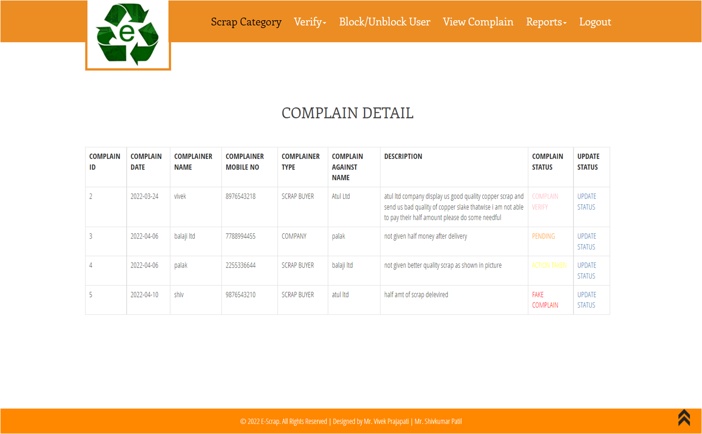
10. Admin View Complain

Slide 32
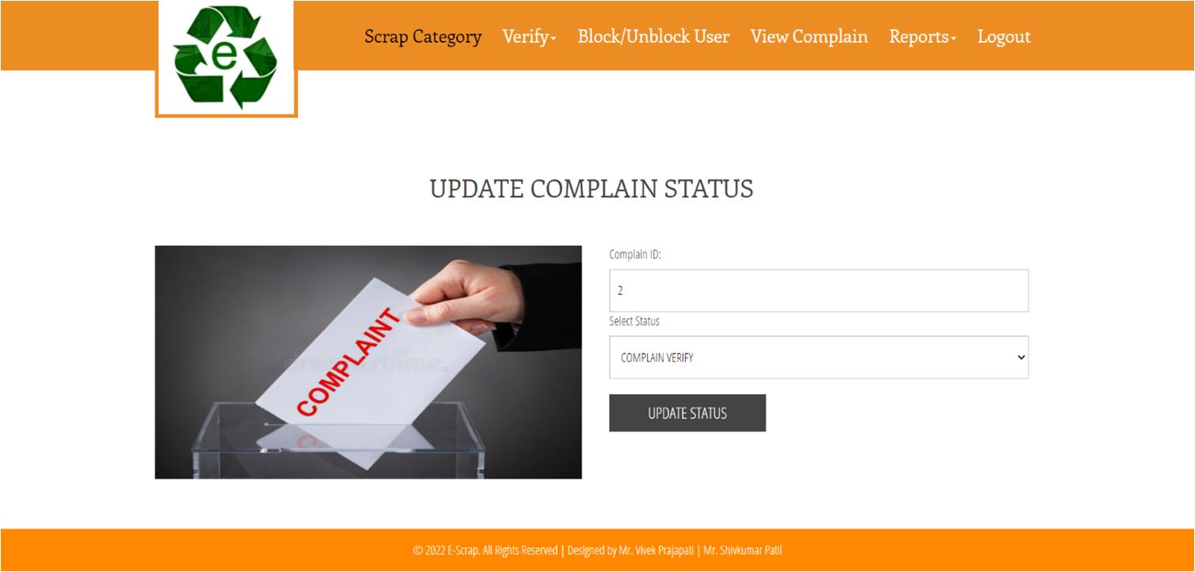
11. Admin Update Complain Status

Slide 33
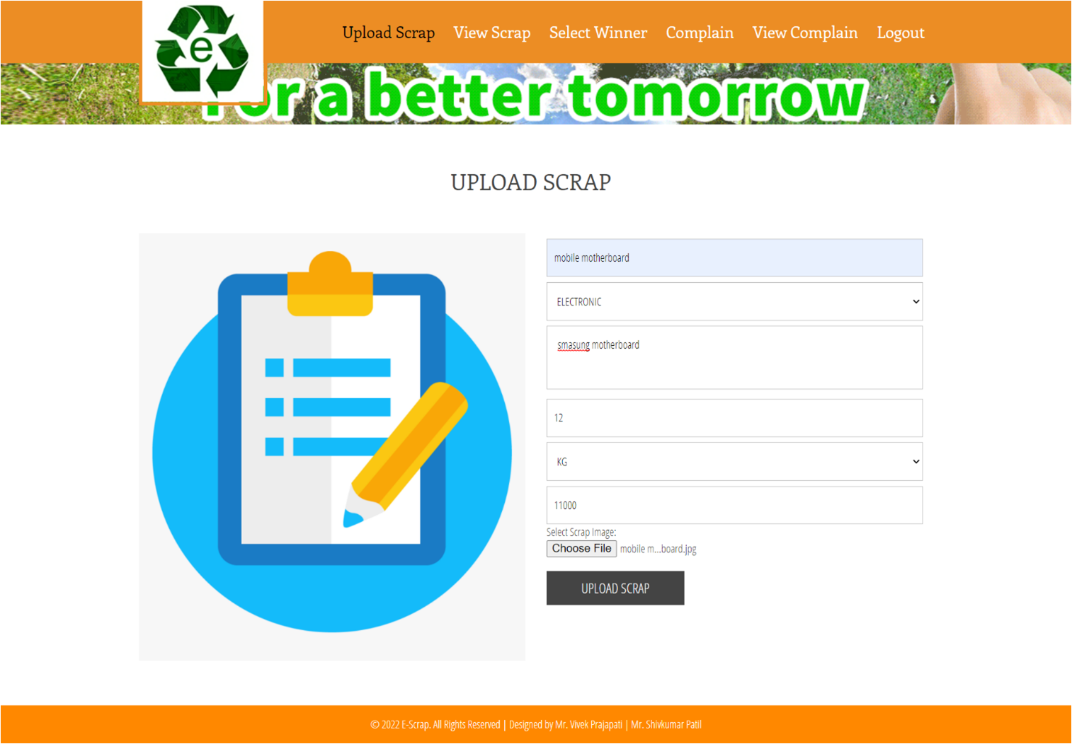
12. Upload Scrap

Slide 34
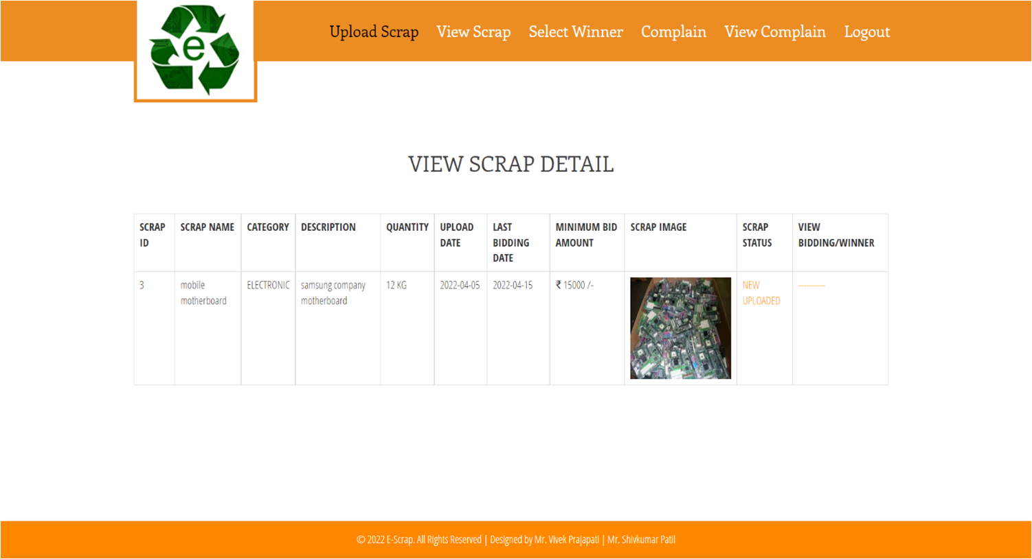
13. View Scrap

Slide 35
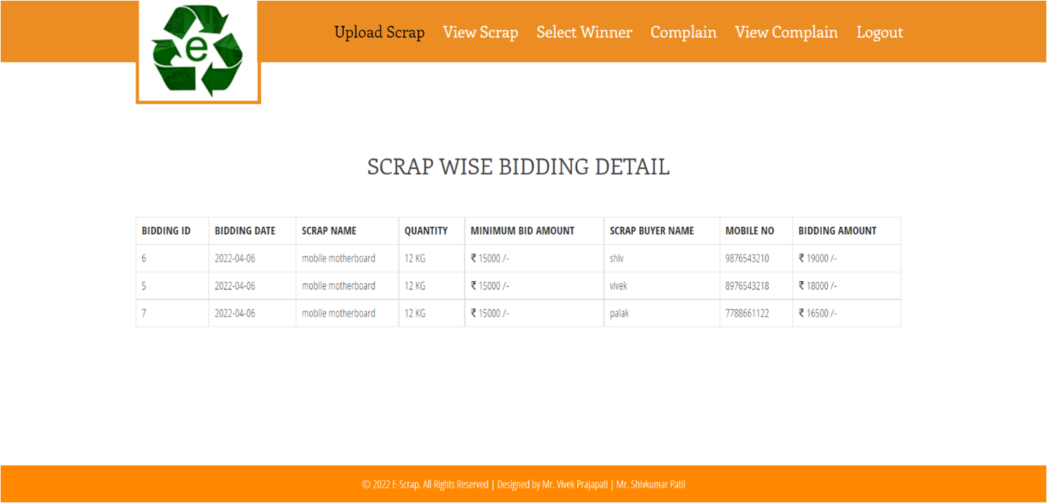
14. Company View Bidding

Slide 36
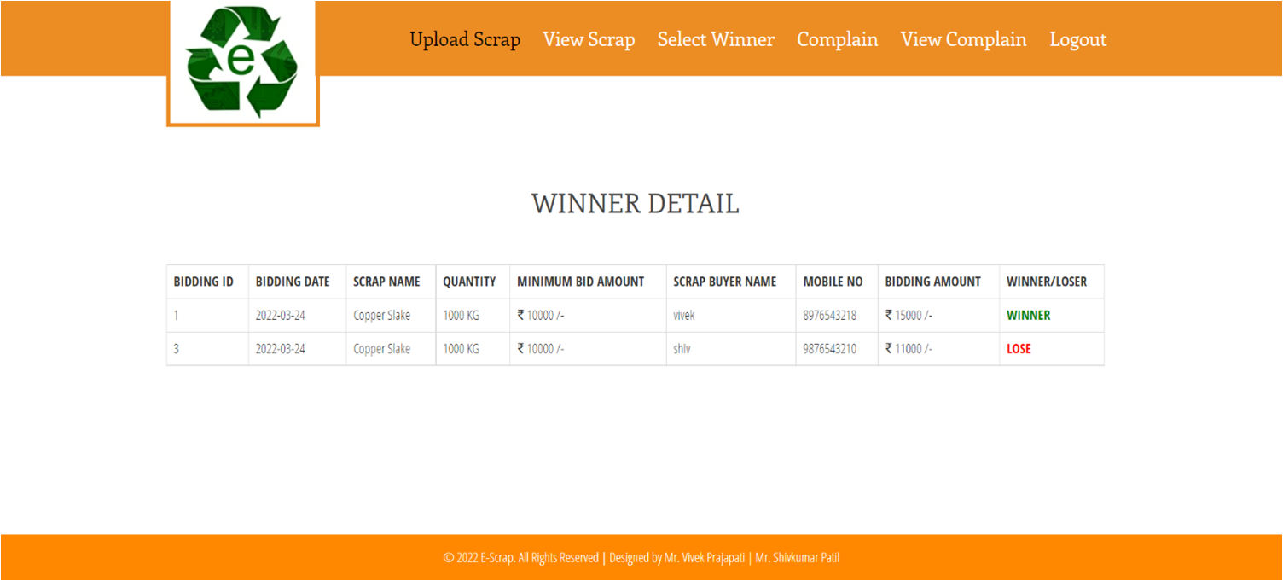
15. Company View Winner

Slide 37

16. Select Winner For Scrap

Slide 38
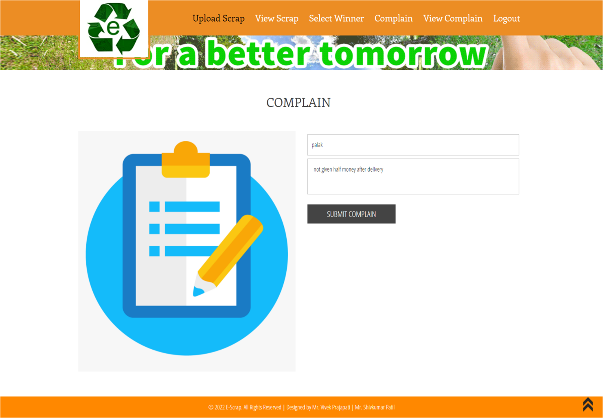
17. Complain

Slide 39
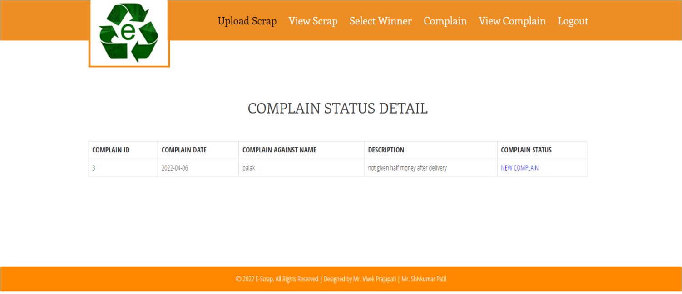
18.View Complain

Slide 40
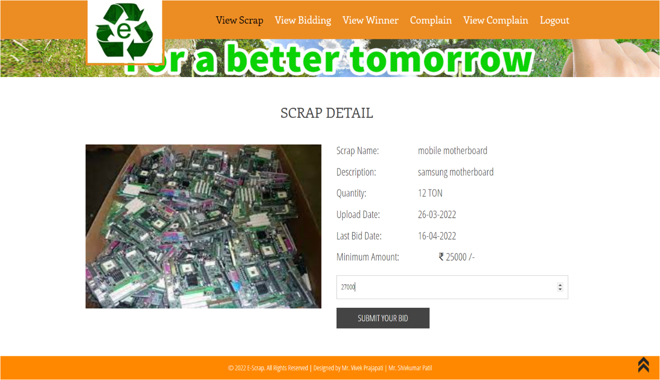
19. Scrap Buyer Bid On Scrap

Slide 41
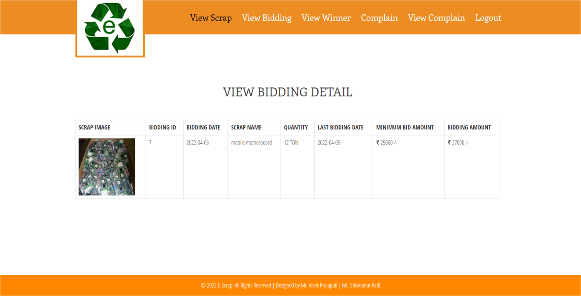
20. View Bidding

Slide 42

21. View Winner

Slide 43
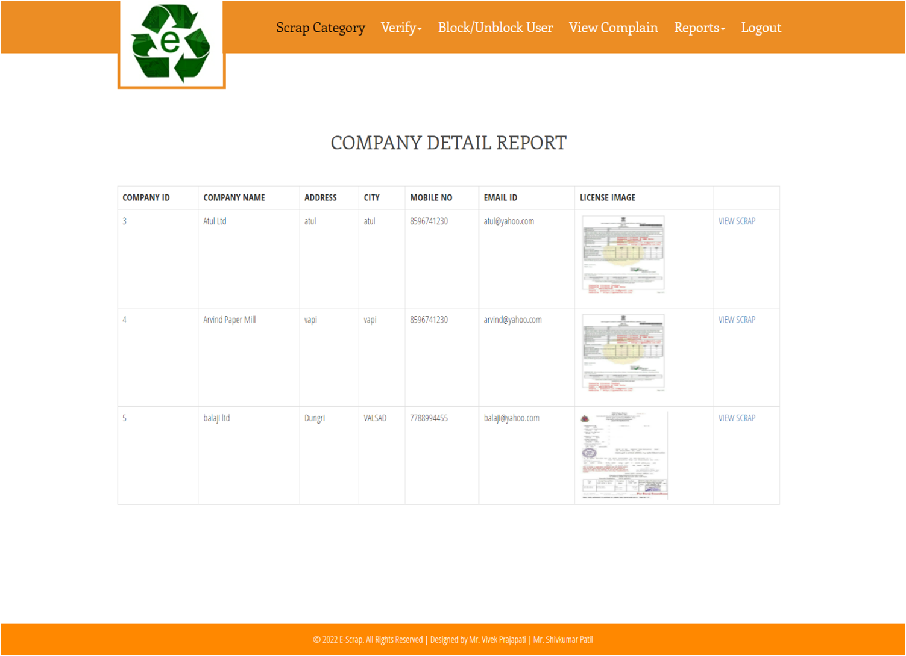
22. Company Detail Report

Slide 44
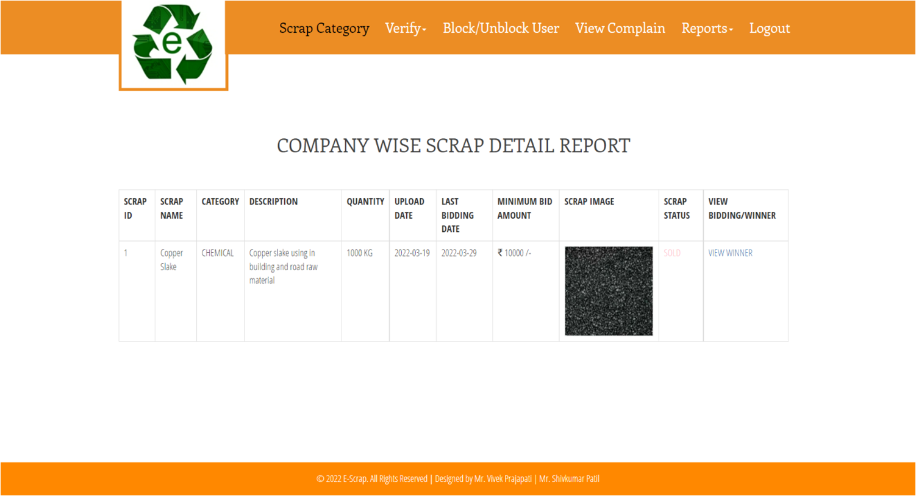
23. Company vise Scrap Detail Report

Slide 45
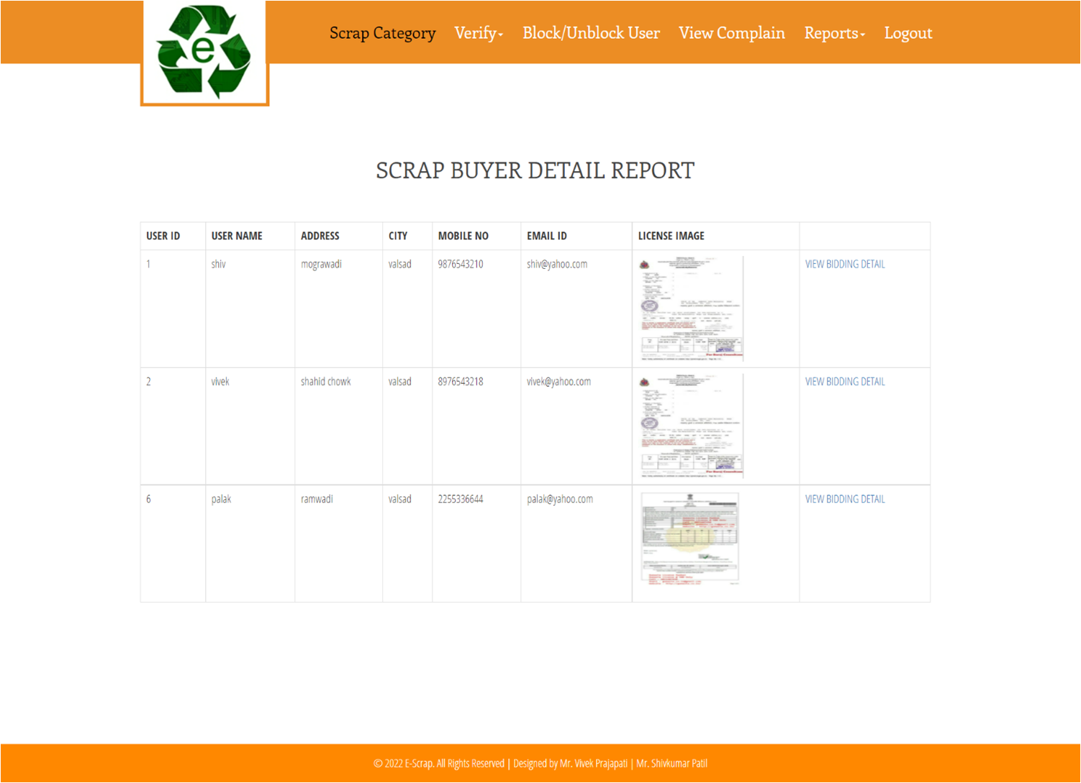
24. Scrap Buyer Detail Report

Slide 46
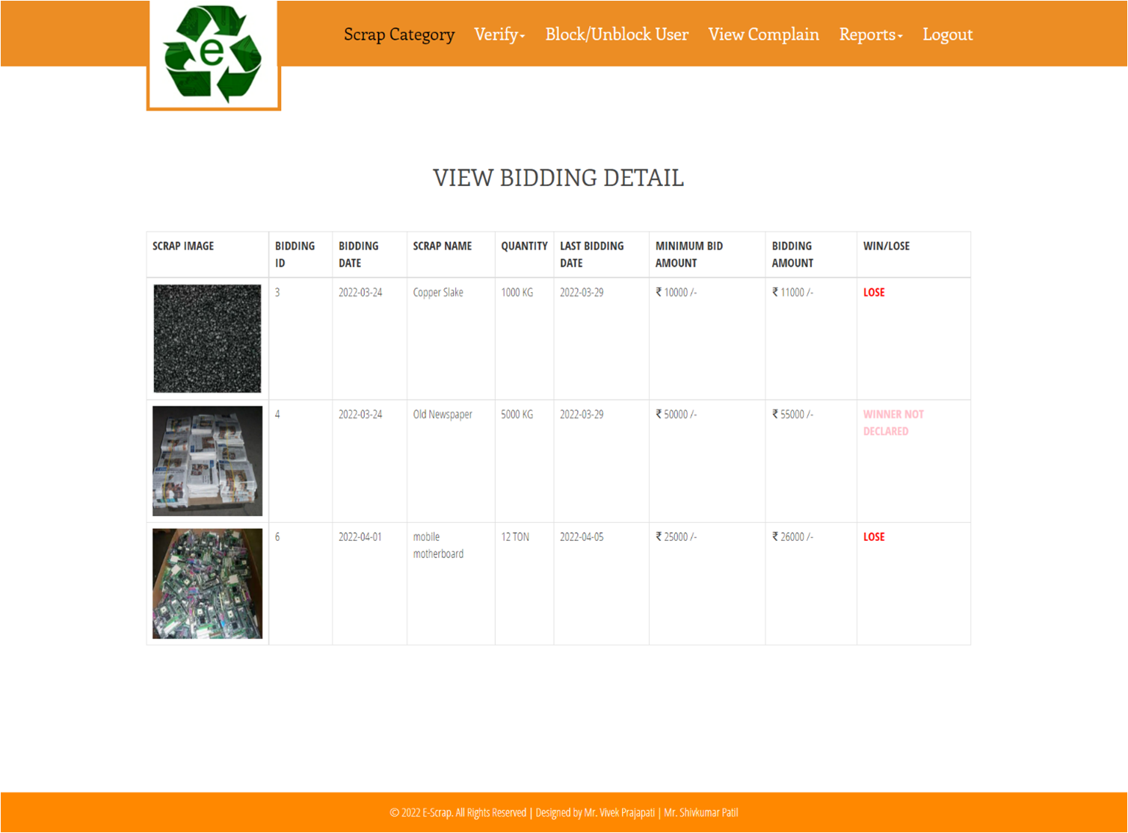
25. View Bidding Detail Report

Slide 47
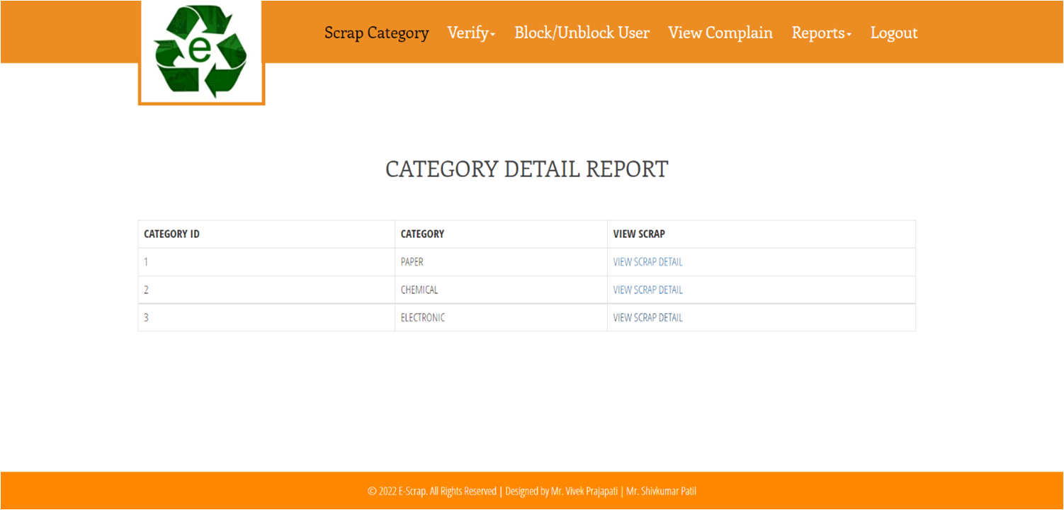
26. Category Detail Report

Slide 48
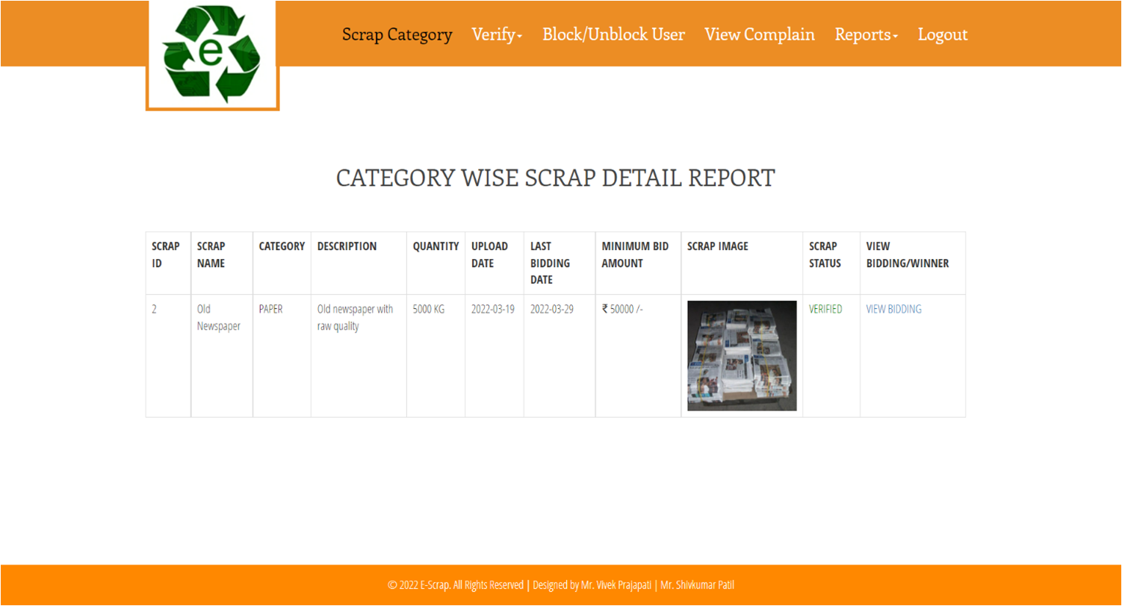
27. Category Vise Scrap Detail Report

Slide 49
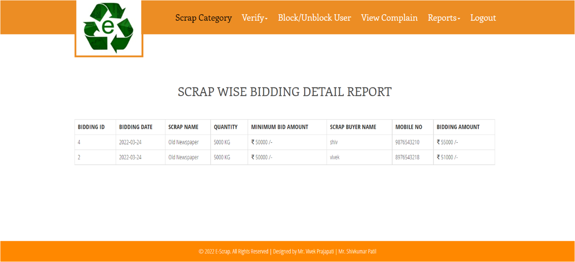
28. Scrap Vise Bid Detail Report

Slide 50
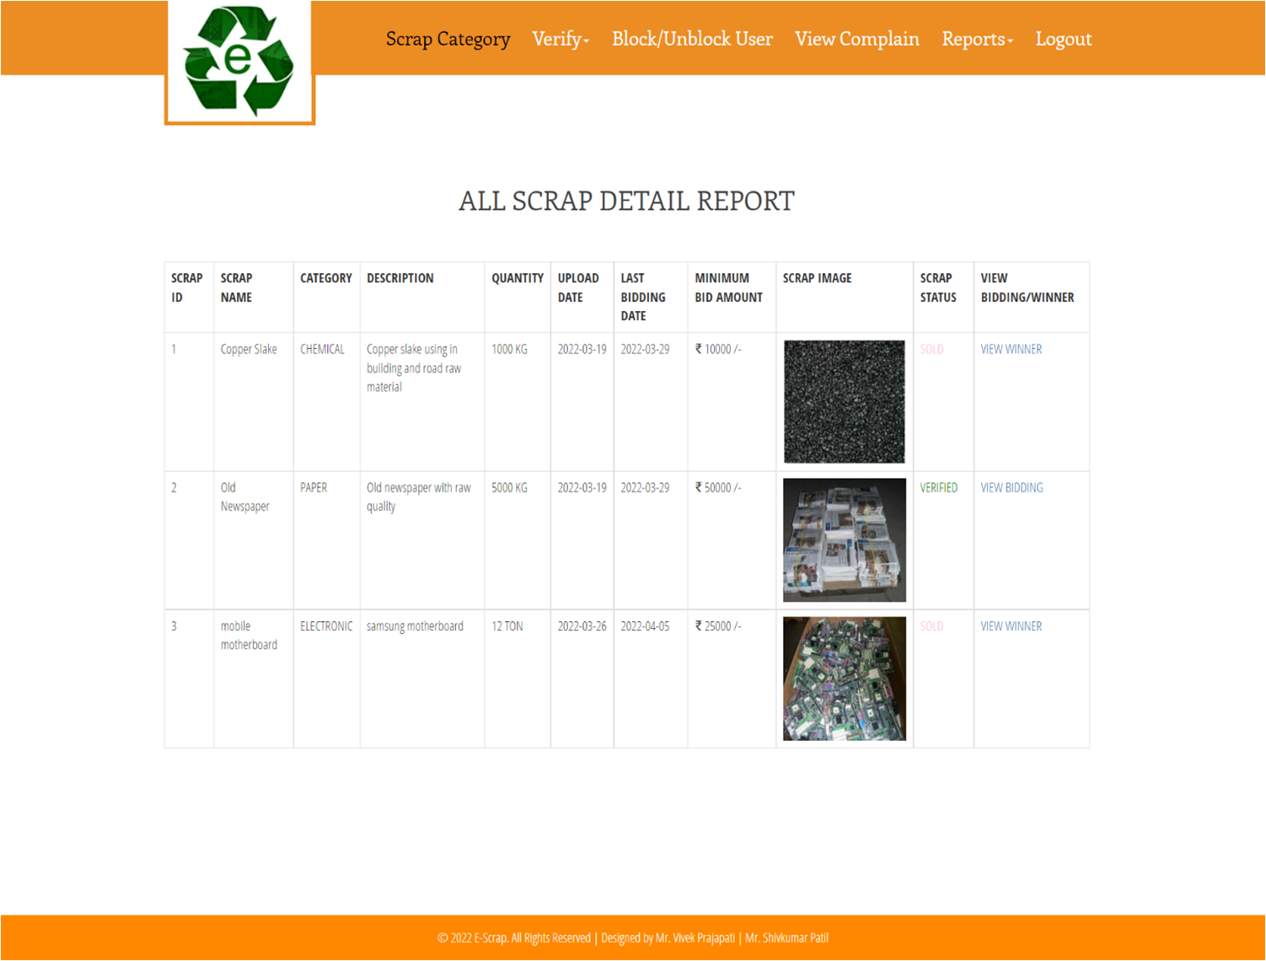
29. All Scrap Detail Report

Slide 51

30. Winner Detail Report

Slide 52
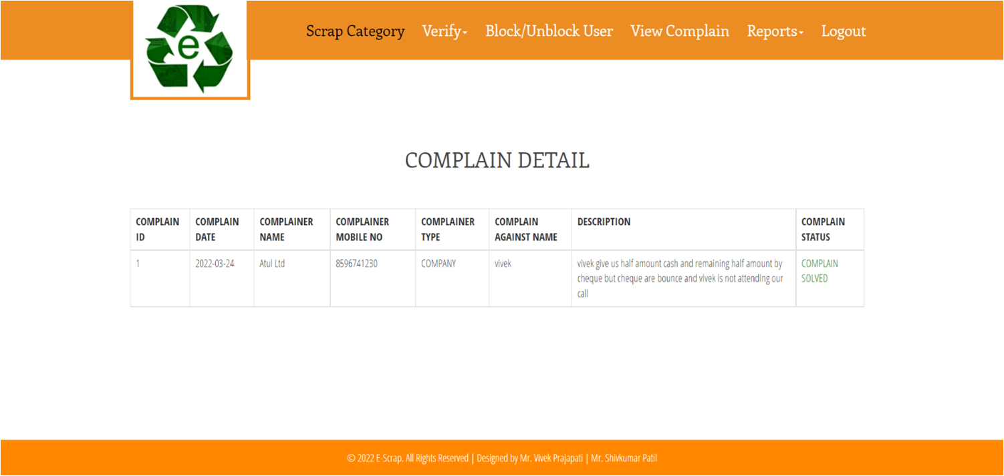
31. Complain Solved Detail Report

Slide 53
5. Testing:
Testing Phase Objectives:
To ensure the application meets the User's requirements and expectations.
To identify and reproduce bugs or issues in the application.
To test the application's performance, functionality, and usability.
To evaluate the application's compatibility with different devices, operating systems, and browsers.
To verify the application's security and data privacy features.

Slide 54
Testing Strategy:
Test early and often: Involve the testing team throughout the development lifecycle to ensure that testing is integrated into the development process.
Use test manual: manually repetitive tasks and tests to save time and resources.
Test in different environments: Test the application in different environments, such as different operating systems or devices, to ensure compatibility and functionality.

Slide 55
6. Future Enhancement:
Add different services and cities.
In future, we will provide E-mail facility as well as SMS facility.
We will create an Android Application for the construction site management.
This is to conclude that the project that we undertook was worked upon with a sincere effort.
Most of the requirement have been fulfilled up to the mark and the requirement which have been remaining, will be completed with a short extension.

Slide 56
7. Bibliography:
Book:
PHP & MYSQL
PHP Solution
Programming PHP
Website:
www.gurukul.com
www.w3schools.com
www.tutorialspoint.com

Slide 57
Thank You.

